Slide 1
Hacking UAVs: the integrity of Wi-Fi, Telemetry and RC links
Author: Mr. Xi Chen, Mr. Jeff Thomas
Notes:
Good afternoon everyone. Thank you for coming to my presentation. Today I am going to talk about the drone related research I have done in the last four months.

Slide 2
Drone Communication Link Vulnerability Tests
Attacks on a parrot AR drone’s Wi-Fi link
Attack on a commercial drone’s telemetry link
Attack on a nano drone’s radio control (RC) link

Slide 3
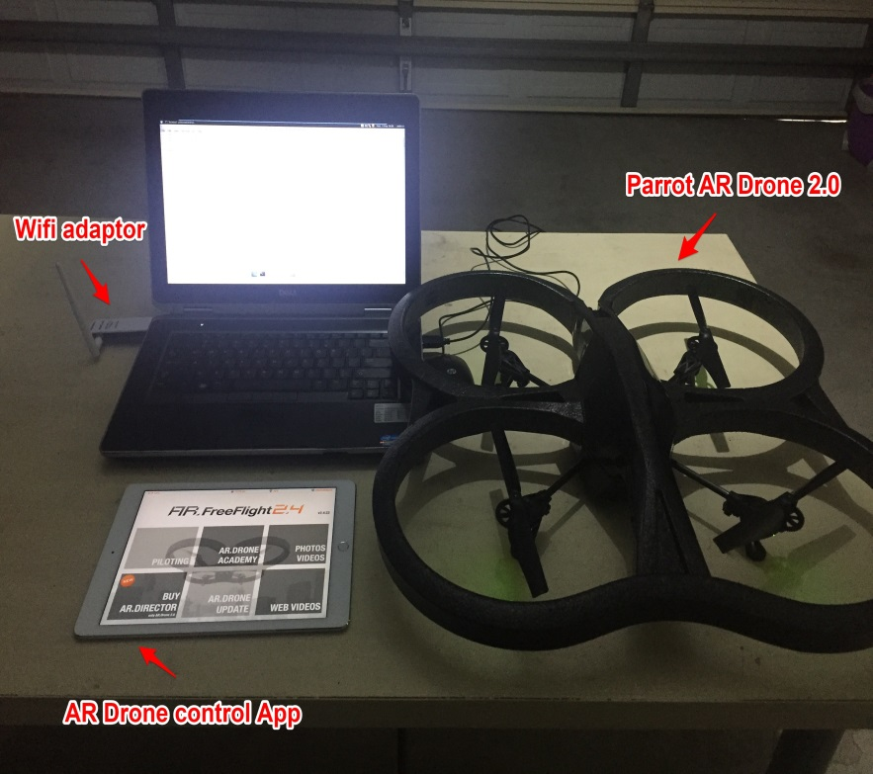
Attack on the Parrot AR.Drone Wi-Fi Link
Controlled by an iOS/Android device via Wi-Fi
Runs a Linux based control firmware
Several weaknesses
Wi-Fi with no encryption
Telnet and FTP enabled with no passwords
Samy Kamkar’s SkyJack is the first AR.Drone hacking software.

Slide 4
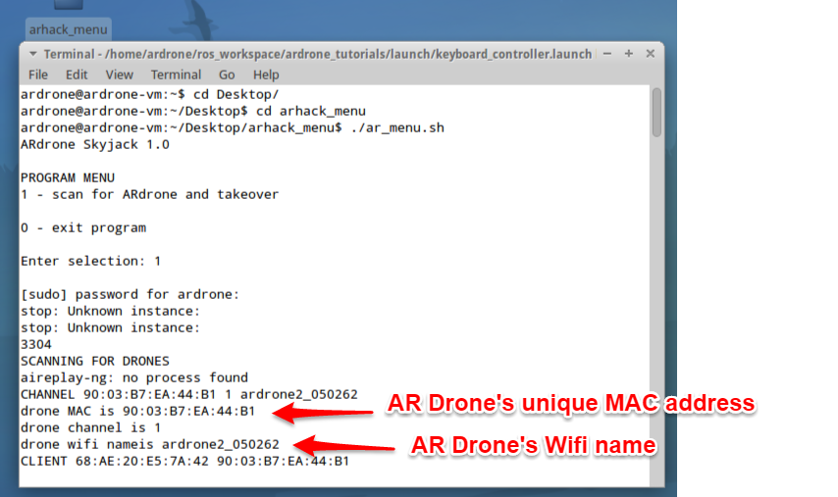
Attack on the Parrot AR Drone Wi-Fi Link
Attack steps
Step 1: Scan for unique MAC addresses that indicate an AR Drone
The MAC address our drone is 90:03:B7:EA:44:B1.

Slide 5
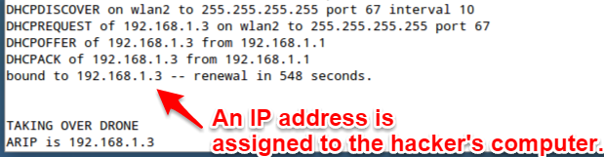
Attack on the Parrot AR Drone Wi-Fi Link
Attack steps
Step 2: Connect to the AR Drone and acquire an IP address via DHCP.

Slide 6
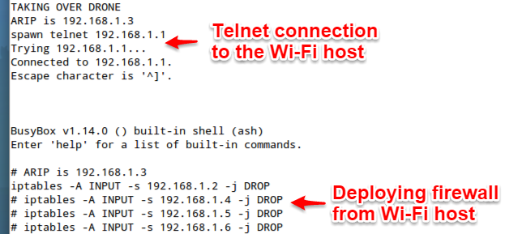
Attack on the Parrot AR Drone Wi-Fi Link
Attack steps
Step 3: Login to the AR Drone using Telnet (with no password!).
Step 4: Add new rules to the built-in firewall to block all possible IP addresses except the IP assigned to the attackers laptop.

Slide 7
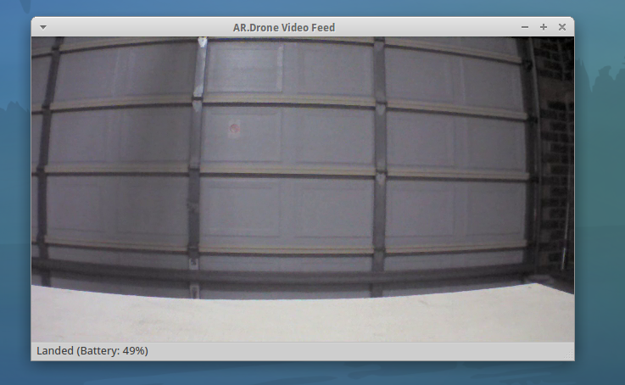
Attack on the Parrot AR Drone Wi-Fi Link
Attack steps
Step 5: Start ROS on the attackers laptop for manual control of the drone using keyboard.

Slide 8
Attack on the Parrot AR Drone Wi-Fi Link
Video

Slide 9
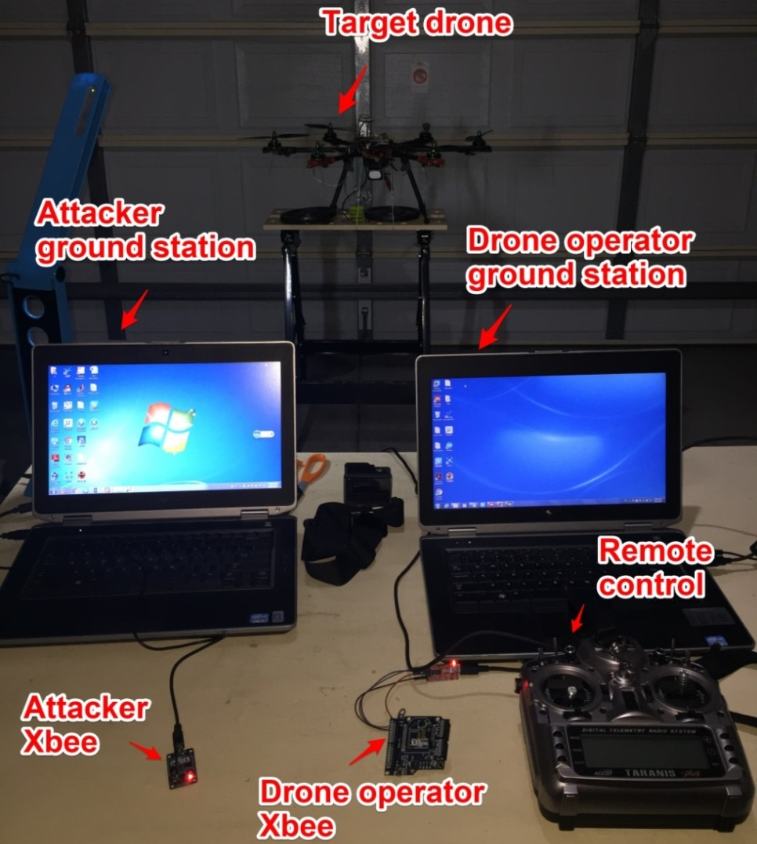
Attack on a Commercial Drone’s Telemetry Link
Test Setup
Nils Rodday presented “Hacking a Professional Drone” at RSA Conference2016
The details of the specific drone was not revealed.

Slide 10
AT transparent mode:
Data is sent out through the serial port exactly as it was received.
AT command mode:
Command mode is used to change the local XBee radio’s configurations.
API mode:
API commands to remotely change the XBee’s configurations.
Personal Area Network (PAN) ID :2006

Slide 11
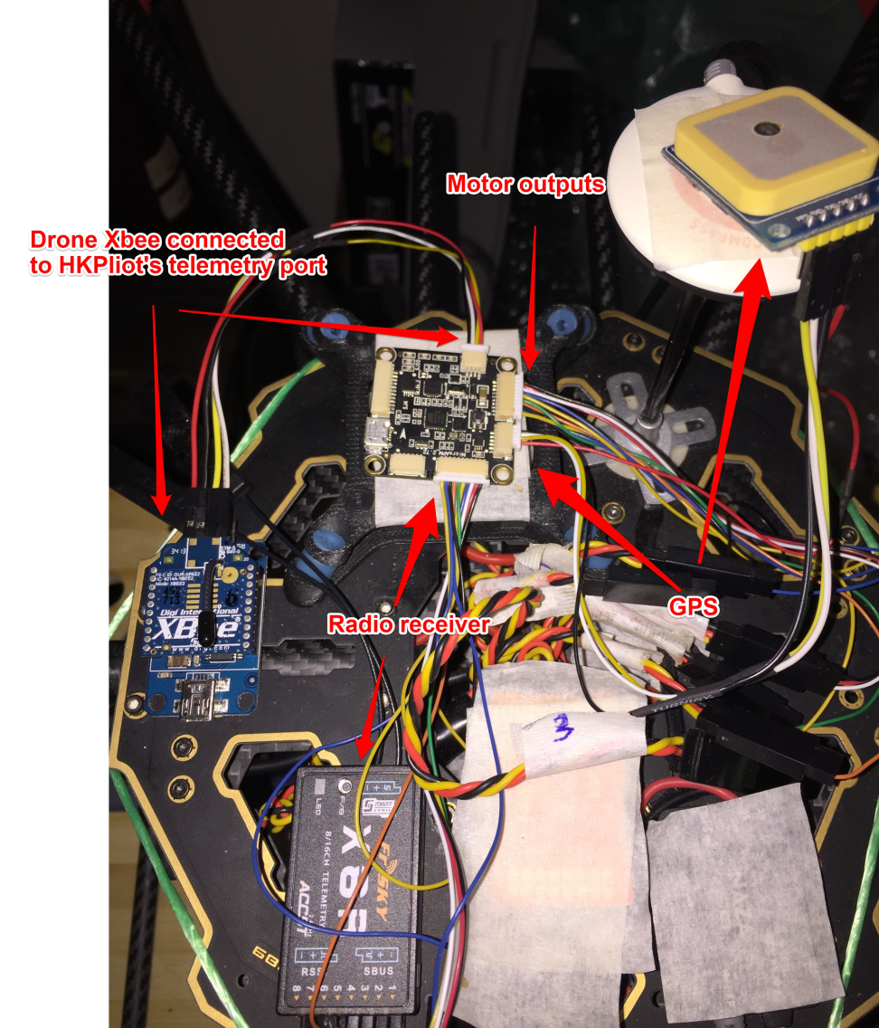
Attack on a Commercial Drone’s Telemetry Link
Test Setup

Slide 12
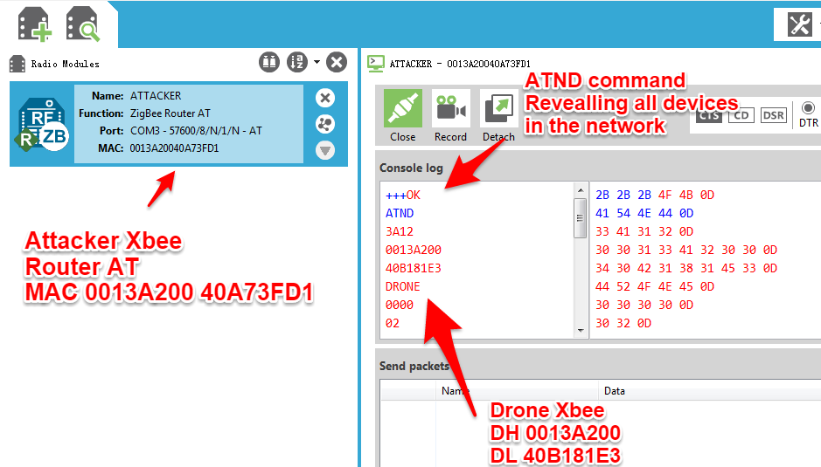
Attack on a Commercial Drone’s Telemetry Link
Attack Steps
Step 1: Configure the attackers XBee radio in AT command mode and send the ATND command to reveal all devices in the XBee network.

Slide 13
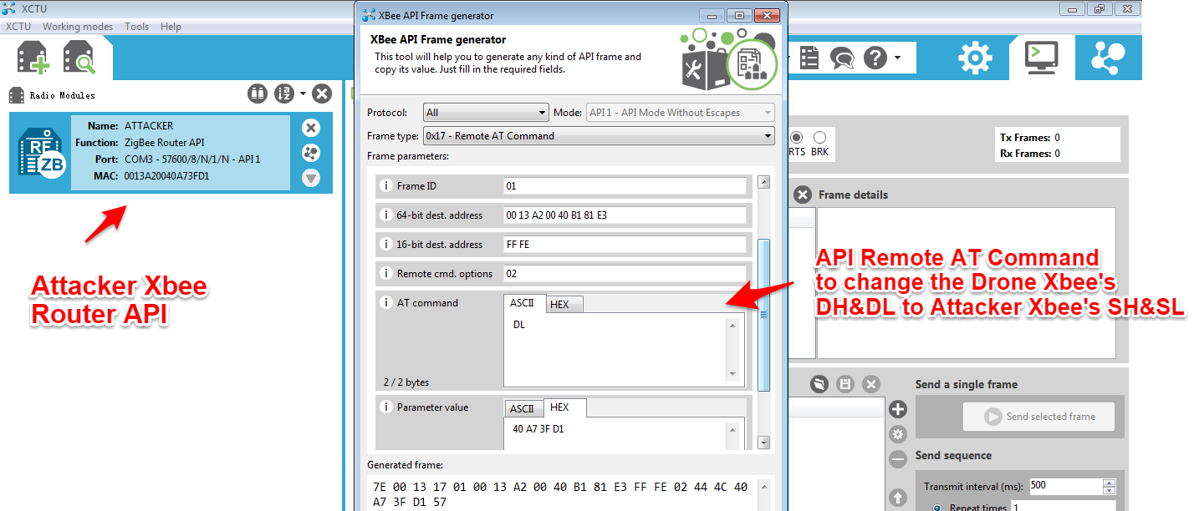
Attack on a Commercial Drone’s Telemetry Link
Attack Steps
Step 2: Change the attackers XBee to API mode and send a Remote AT Command to change the drone XBee's DH&DL.

Slide 14
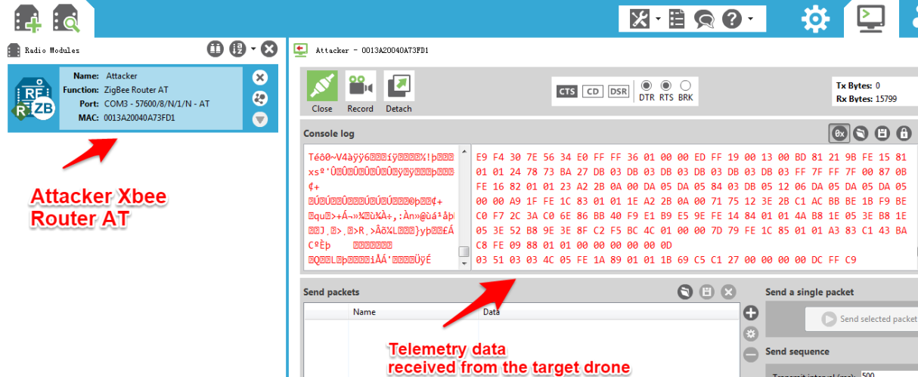
Attack on a Commercial Drone’s Telemetry Link
Attack Steps
Step 3: Change the attackers XBee back to AT transparent mode and start receiving telemetry data from the drone.

Slide 15
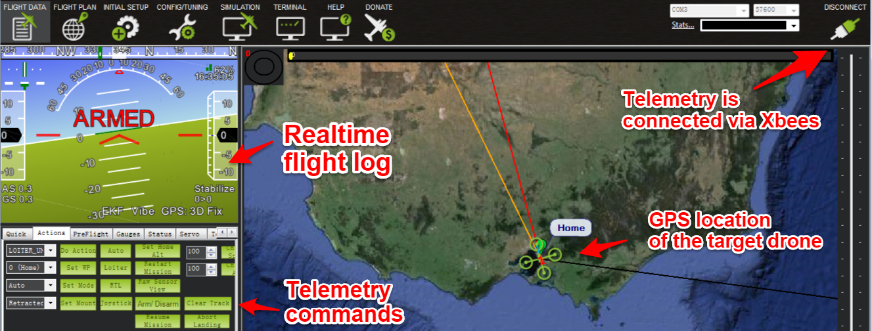
Attack on a Commercial Drone’s Telemetry Link
Attack Steps
Step 4: Start mission planner on the attacker’s laptop and take control of the drone.

Slide 16
Attack on a Commercial Drone’s Telemetry Link
Video

Slide 17

Attack on a Drone’s Radio Control (RC) Link
Positive Research Center ran a contest of taking control over a Syma drone.
Two hacking methods: SDR and nRF24L01

Slide 18
Attack on a Drone’s Radio Control (RC) Link
Hardware List

Slide 19
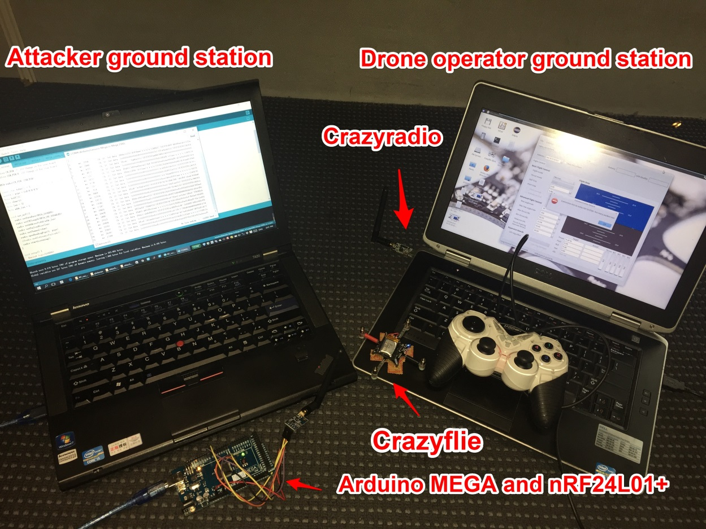
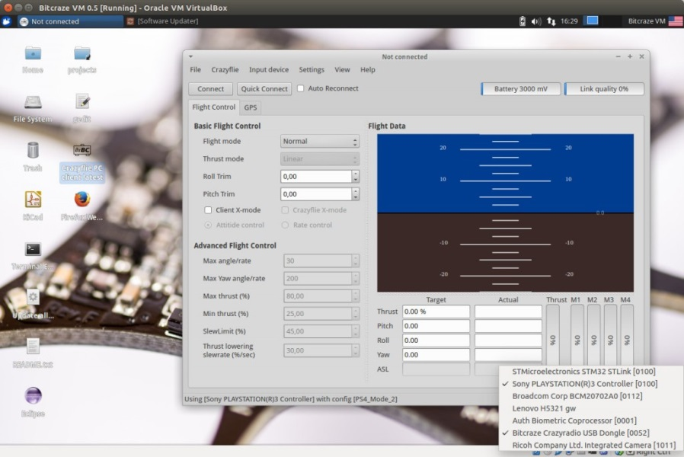
Attack on a Drone’s Radio Control (RC) Link
Overall Attack Setup
Attack setup
Crazyflie PC client

Slide 20
Attack on a Drone’s Radio Control (RC) Link
nRF24L01 Communication
In order to send or receive message form an nRF24L01+ radio, one needs to know its address (pipe), channel and air data rate.
nRF24L01+ has three air data rates: 250kbps, 1Mbps or 2Mbps.
nRF24L01+ can operate on frequencies from 2.400GHz to 2.525GHz.
The programming resolution of the RF channel frequency setting is 1MHz.

Slide 21
Attack on a Drone’s Radio Control (RC) Link
Enhanced ShockBurst Packet
The preamble is used to synchronize the receiver’s demodulator to the incoming bit stream
The address, which comes after the preamble, ensures that the packet is detected and received by the correct receiver.
The payload is the user defined content of the packet.

Slide 22
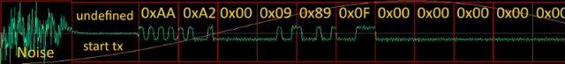
Attack on a Drone’s Radio Control (RC) Link
Enhanced ShockBurst Packet
The waveform begins with 0x00
The preamble is either 01010101 (0x55) or 10101010 (0xAA)
First two bytes of the data package is be 0x00AA or 0x0055

Slide 23
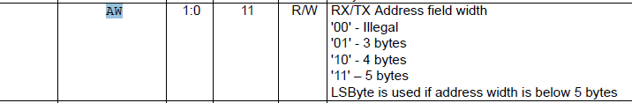
Attack on a Drone’s Radio Control (RC) Link
Enhanced ShockBurst Packet
What the manual says is:
What in reality is:
If we write ‘00’ to the AW register, the address length will be set to 2 bytes.

Slide 24
Attack on a Drone’s Radio Control (RC) Link
Enhanced ShockBurst Packet
So We can set the receiver address to be 0x00AA or 0x0055.
The receiver’s address becomes the same as the data packet’s first two bytes
All data packets will be received
The preamble in this case is interpreted as the “address”
The actual address of the data packet is interpreted as the “payload” and become accessible

Slide 25
Attack on a Drone’s Radio Control (RC) Link
Attack Steps
uint64_t pipe = 0x00aa;
byte buff[32];
byte chan=10;
byte len = 32;
byte addr_len = 2;
void set_nrf(){
radio.setDataRate(RF24_250KBPS);
radio.setCRCLength(RF24_CRC_DISABLED);
radio.setAddressWidth(addr_len);
radio.setPayloadSize(len);
radio.setChannel(chan);
radio.openReadingPipe(1, pipe);
radio.startListening(); }
Step 1: Configure nRF24L01+ receiver
Set the receiver address width to be 2 bytes. Write 0x00AA or 0x0055 to the AW register. Turn off the Cyclic Redundancy Check (CRC).

Slide 26
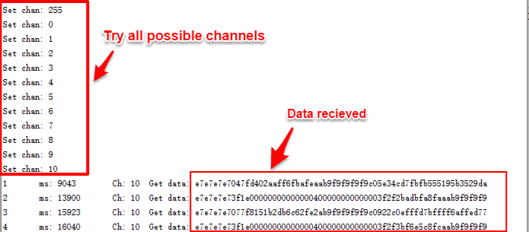
Attack on a Drone’s Radio Control (RC) Link
Attack Steps
Step 2: Detect the air data packet’s parameters

Slide 27
Attack on a Drone’s Radio Control (RC) Link
Attack Steps
Step 2: Detect the air data packet’s parameters
void RF24::setAutoAck(bool enable)
{
if ( enable )
write_register(EN_AA, 0b111111);
else
write_register(EN_AA, 0);
}
#define ARC 0

Slide 28
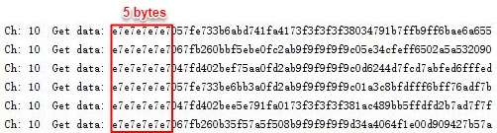
Attack on a Drone’s Radio Control (RC) Link
Attack Steps
Step 2: Detect the air data packet’s parameters

Slide 29
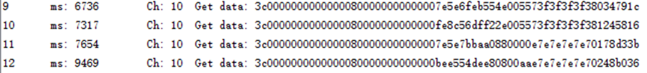
Attack on a Drone’s Radio Control (RC) Link
Attack Steps
Step 3: Start receiving the commander packets
Set the receiver address width to be 5 bytes. Write 0xe7e7e7e7e7 to the AW register.
15 bytes

Slide 30
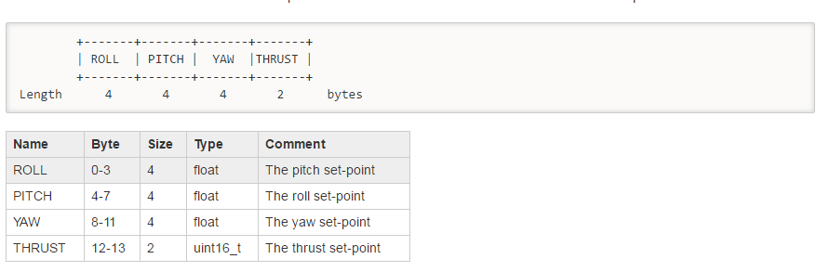
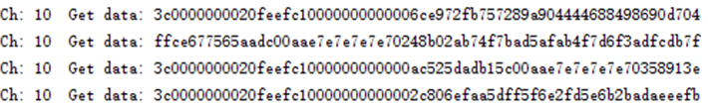
Attack on a Drone’s Radio Control (RC) Link
Attack Steps
Step 3: Start receiving the commander packets
6th-9th byte
The 6th to 9th byte change to 0x20feefc1, when the pitch angle reference changes to 30 degree

Slide 31
Attack on a Drone’s Radio Control (RC) Link
Future Work
Write Arduino script to control the Crazyflie using our costume nRF24L01+ radio.
Explore how to remotely change the channel and air data rate setting of the Crazyflie and Crazyradio, so that the original Crazyflie operator can be disconnected.
Explore the weakness of RC radios with frequency hopping feature

